Slide 1
Programming without code
Group 13

Slide 2
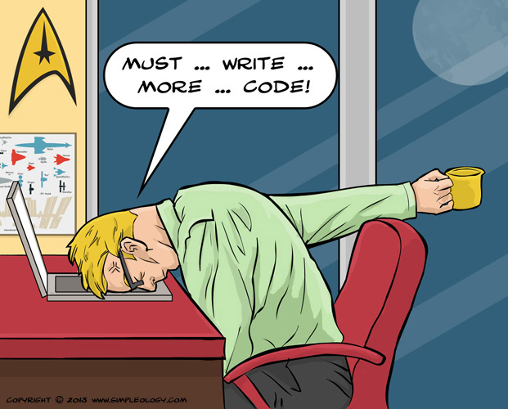
Why this project ?
.

Slide 3

The difficulty of writing

Slide 4

Solution : PWCT

Slide 5
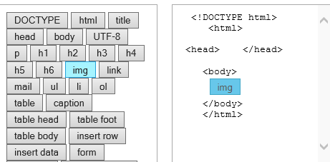
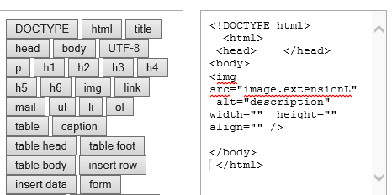
What is the Programming without code?
It’s a feature that help the web programmer to write and edit the code in a simple way .

Slide 6
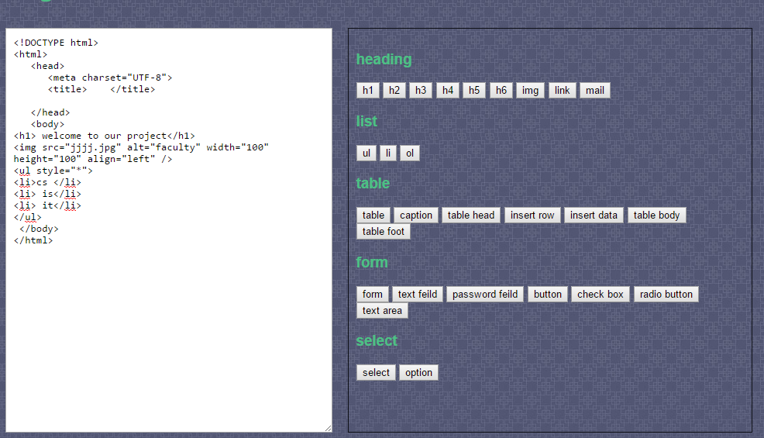
Steps of using this online text editor
Finally begin to write your code

Slide 8
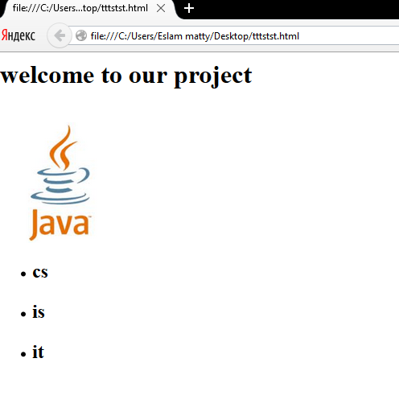
Then run your code

Slide 9
NAMES:
. Mohammed AbdElhameed
. Abdelrahman Abouzaid
. Belal Mahroos
. Tarek Hassan
. Mohammed Shawky
. Basuony Galal
. Eslam AbouAlmaatty

Slide 10
THANKS

